Slide 1


Python Exercise
String data type

Slide 2
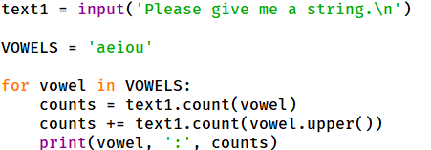
Question 1.1
Fill correct code in the blank place. The program will accept a string, and find VOWELs and count how many times each vowel appears inside the string

Slide 3
Question 1.2
Fill correct code in the blank place. The program will accept a string, and find VOWELs and count how many times each vowel appears inside the string

Slide 4
Question 1
answer

Slide 5
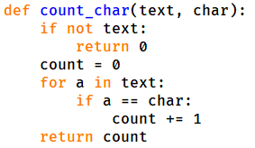
Question 2.1
Fill correct code in the blank place. The program defines a function count_char, which takes 2 arguments: one string, one character. It will return inside the string, the character appeared how many times.

Slide 6
Question 2.2
Fill correct code in the blank place. The program defines a function count_char, which takes 2 arguments: one string, one character. It will return inside the string, the character appeared how many times.

Slide 7
Question 2.2
answer.

